Slide 1
Introduction to Kubernetes

Slide 2
What is Kubernetes?
Kubernetes (K8s) is an open-source system for automating deployment, scaling and management of containerized applications.
Google Kubernetes is highly flexible container tool to deliver even complex applications, consistently. Applications run on clusters of hundreds to thousands of individual servers.
Kubernetes flexibility grows with you to deliver your applications consistently and easily no matter how complex the need is.
Kubernetes is open source giving the freedom to take advantage of on-premises, hybrid, or public cloud infrastructure, effortlessly allowing to move workloads.
Ref: https://kubernetes.io/

Slide 3
Why Kubernetes?
Kubernetes can run on-premises bare metal, OpenStack, public clouds Google, Azure, AWS, etc.
Helps to avoid vendor lock issues as it can use any vendor-specific APIs or services .
Containerization using Kubernetes allows package software that enables applications which needs to be released and updated without any downtime.

Slide 4
Kubernetes Features
Automated Scheduling
Self-Healing Capabilities
Automated rollouts & rollback
Horizontal Scaling & Load Balancing
Offers environment consistency for development, testing, and production
Infrastructure is loosely coupled to each component can act as a separate unit
Provides a higher density of resource utilization
Offers enterprise-ready features
Application-centric management
Auto-scalable infrastructure
Create predictable infrastructure

Slide 5
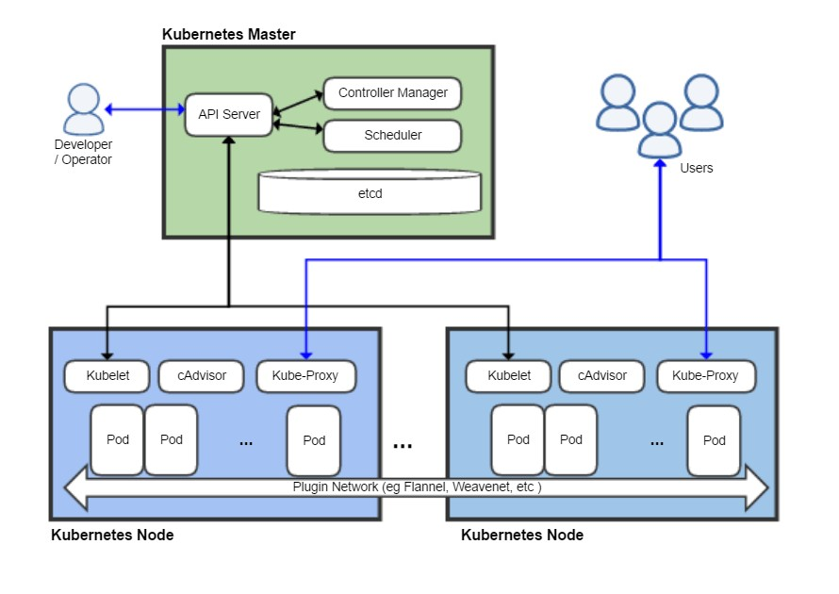
Kubernetes Architecture

Slide 6
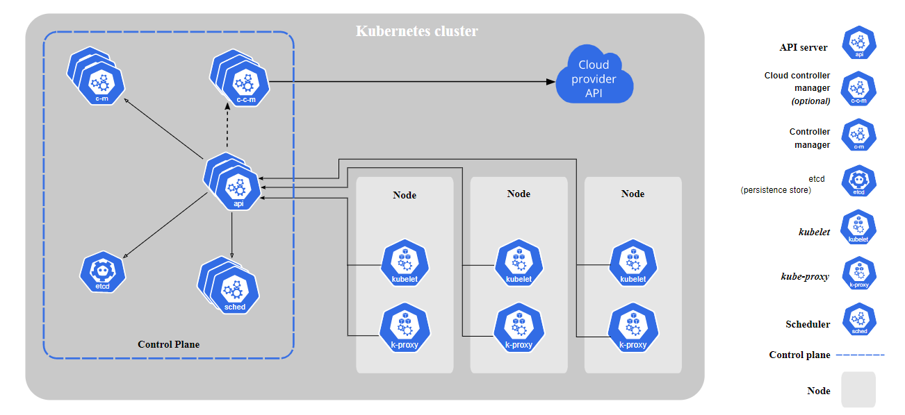
Kubernetes Components
Ref: https://kubernetes.io/docs/concepts/overview/components/

Slide 7
Kubernetes Components
Cluster:
It is a collection of hosts(servers) that helps to aggregate the available resources which includes RAM, CPU, Disk and their devices into a usable pool.
Master:
Master is a collection of components which make up the control plane of Kubernetes. These components are used for all cluster decisions. It includes both scheduling and responding to cluster events.
Node:
It is a host which is capable of running on a physical or virtual machine. A node should run both kube-proxy, minikube, and kubelet which are considered as a part of the cluster.

Slide 8
Kubernetes Master Components
API Server:
Key component which provides both the internal and external interface to Kubernetes using REST API
Kubernetes Scheduler:
Component in charge of determining which node is most suitable for running pods
Controller Manager :
Controller manager is responsible for monitoring replication controllers, and creating corresponding pods to achieve the desired state.
etcd :
Persistent, lightweight, distributed, key value data store developed by CoreOS that reliably stores the configuration data of the cluster, representing the overall state of the cluster at any given point of time.

Slide 9
Kubernetes Node Components
kubelet
An agent that runs on each node in the cluster. It makes sure that containers are running in a Pod.
kube-proxy
kube-proxy is a network proxy that runs on each node in your cluster, implementing part of the Kubernetes Service concept.
Container Runtime
The container runtime is the software that is responsible for running containers.
Kubernetes supports several container runtimes: Docker, rkt..etc

Slide 10
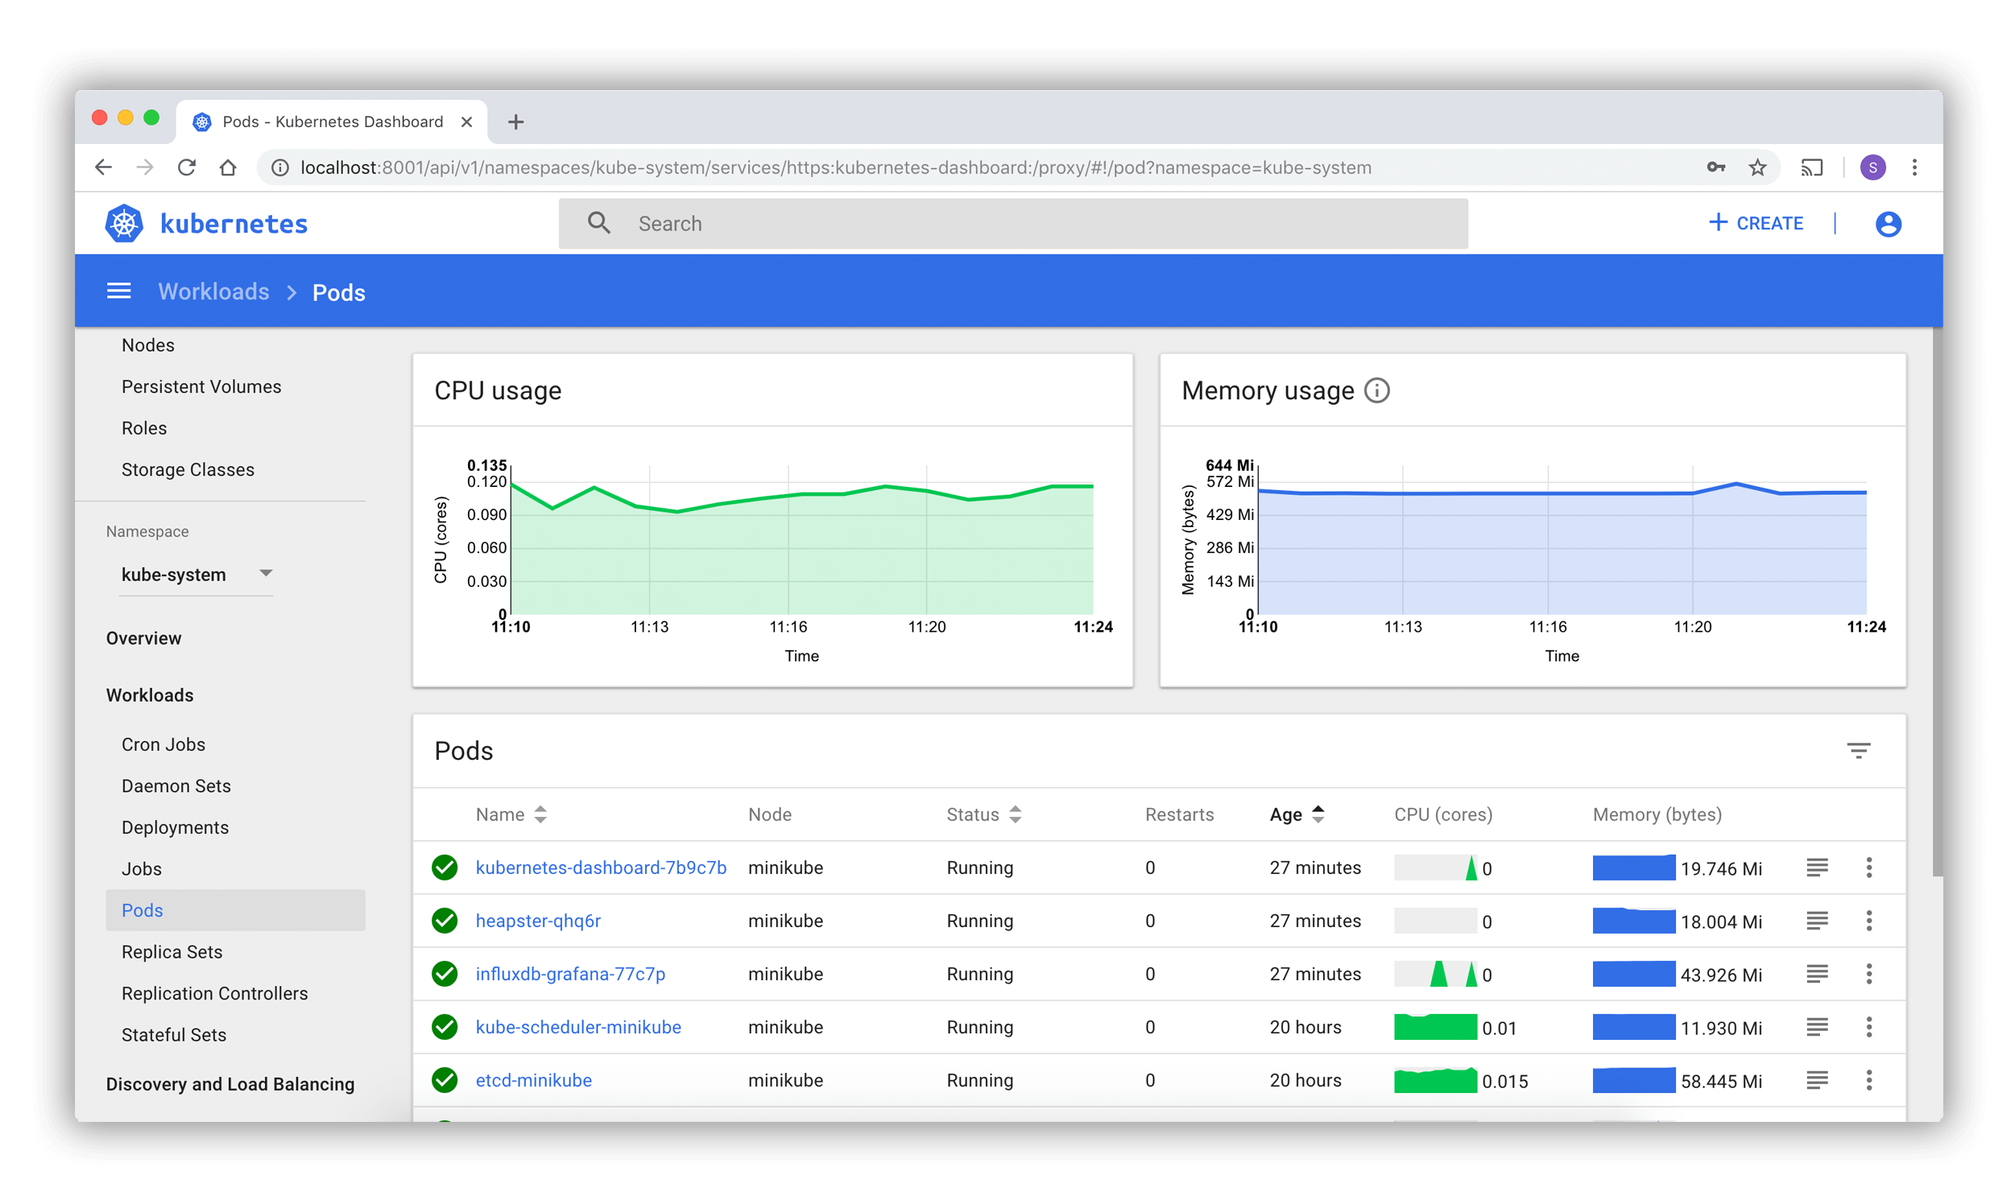
Kubernetes Dashboard
Ref :https://kubernetes.io/docs/tasks/access-application-cluster/web-ui-dashboard/

Slide 11
Stacked etcd topology
A stacked HA cluster is a topology where the distributed data storage cluster provided by etcd is stacked on top of the cluster formed by the nodes managed by kubeadm that run control plane components.

Slide 12
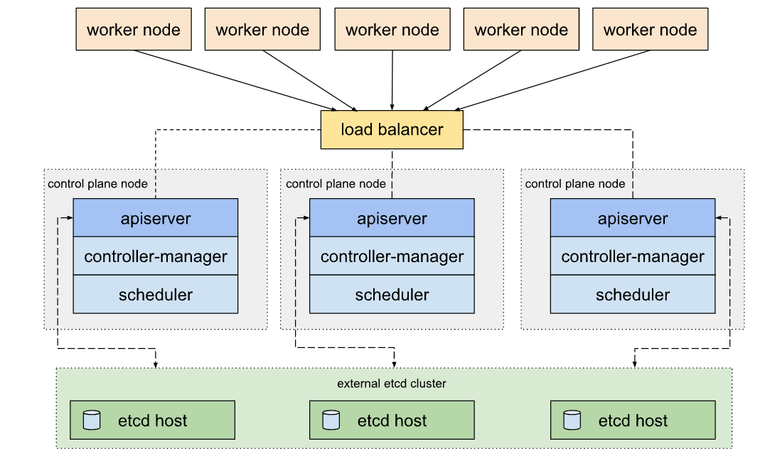
External etcd topology
An HA cluster with external etcd is a topology where the distributed data storage cluster provided by etcd is external to the cluster formed by the nodes that run control plane components

Slide 13
Kubernetes Installation

Slide 14
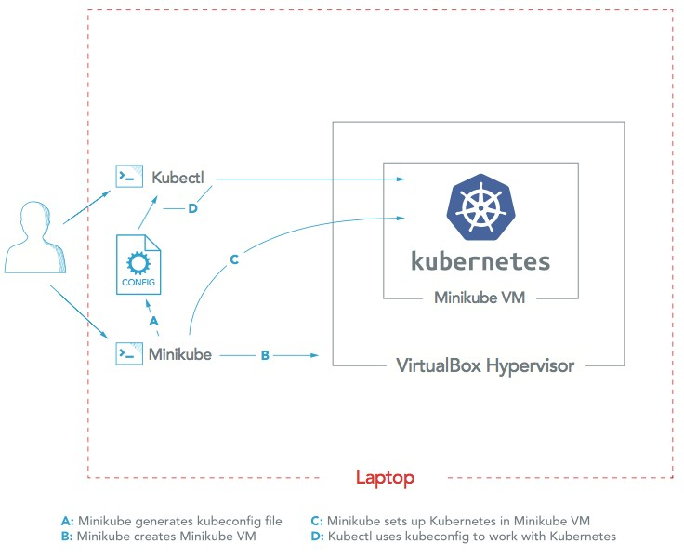
Kubernetes Installation Models
Kubernetes using Minikube (Single Node Cluster)
Use case: Developer Sandbox
Pros: Convenience, Localized Sandbox, testing, exploration
Cons: Unsuitable for production, cannot scale, cannot be shared
Ref:https://kubernetes.io/docs/tasks/tools/install-minikube/

Slide 15
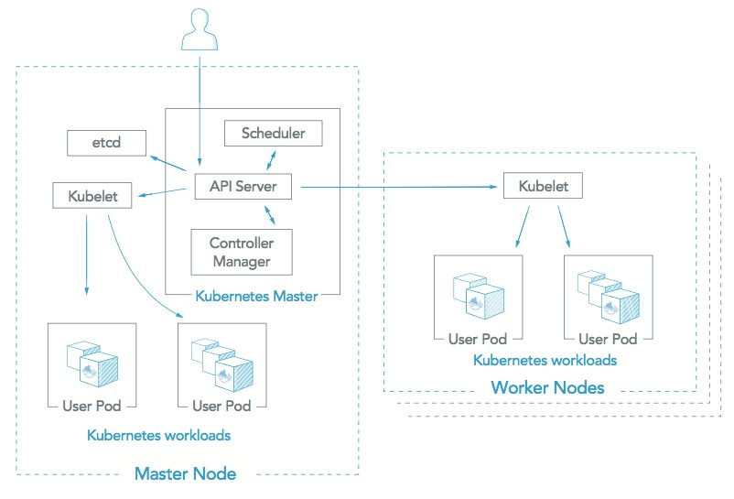
Kubernetes using kubeadm
Installer-based Kubernetes (Kubeadm)
Use case: Customized Kubernetes installation
Pros: Customizability, scalability
Cons: Time and resource intensive, requires ongoing maintenance
Ref:https://kubernetes.io/docs/setup/production-environment/tools/kubeadm/create-cluster-kubeadm/

Slide 16
Kubernetes using kubeadm
Kubeadm is the right tool to bootstrap the Kubernetes cluster on your virtual machines
Performs the actions necessary to get a minimum viable cluster up and running
Automates the installation and configuration of Kubernetes components such as the API server, Controller Manager, and Kube DNS
A simple way to install Kubernetes and automate setting up a cluster and test their applications
kubeadm allows to create a control-plane node in phases using the kubeadm init phase command
kubeadm join command initializes a Kubernetes worker node and joins it to the cluster

Slide 17
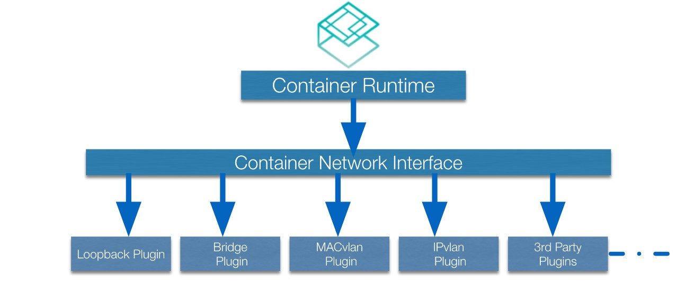
Container Network Interface (CNI)
Container networking Interface is the mechanism through which containers can optionally connect to other containers, the host, and outside networks like the internet.
Container runtimes offer various networking modes and various plugins

Slide 18
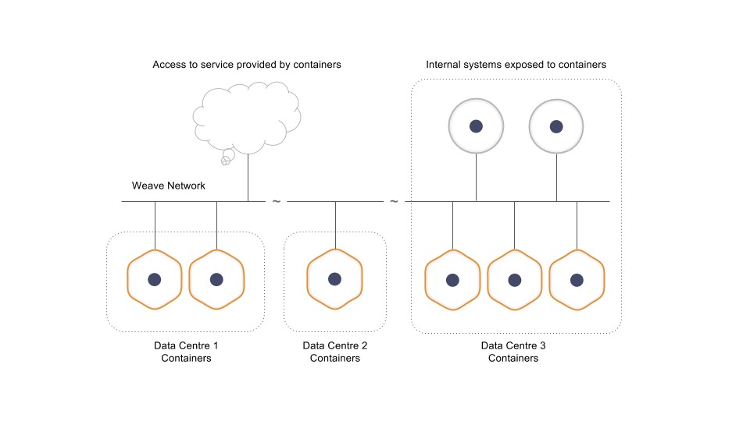
CNI Plugins
◆ Calico
◆ Flannel
◆ Weave

Slide 19
CNI Plugins
Flannel, a project developed by the CoreOS, is perhaps the most straightforward and popular CNI plugin available.
It is one of the most mature examples of networking fabric for container orchestration systems, intended to allow for better inter-container and inter-host networking.
Flannel configures a layer 3 IPv4 overlay network
Calico is best known for its performance, flexibility, and power.
Calico takes a more holistic view of networking, concerning itself not only with providing network connectivity between hosts and pods, but also with network security and administration.
Project Calico is a good choice for environments that support its requirements and when performance and features like network policy are important.
Weave Net by Weaveworks is a CNI-capable networking option for Kubernetes which creates a mesh overlay network between each of the nodes in the cluster, allowing for flexible routing between participants.
It is relatively easy to set up, offers many built-in and automatically configured features, and can provide routing in scenarios where other solutions might fail.

Slide 20






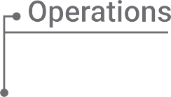









Managed Kubernetes Services

Slide 21
Managed Kubernetes Services
Open Source system approach for automating deployment, scaling, and management of containerized applications.
No need to install, manage, operate and scale Kubernetes clusters across the enterprise data center.
Provides a platform for automating deployment, scaling, and operations of the application and make it easy to run Kubernetes on AWS, Microsoft Azure, Google Cloud without needing to install and operate your own Kubernetes Cluster.

Slide 22
Kubernetes Namespaces and Pods

Slide 23
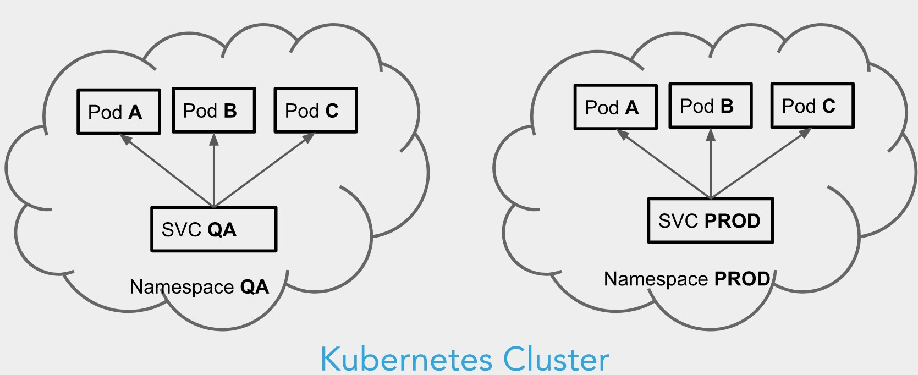
Kubernetes Namespaces

Slide 24
Kubernetes Namespace
Kubernetes objects which partitions a single Kubernetes Cluster into multiple Virtual Clusters
By default the below 3 namespaces are created in a Kubernetes Cluster
default
kube-system
kube-public

Slide 25
Use Cases of Namespaces
To segregate cluster resources across different teams, users and applications
Specify Resource Consumption policies like Resource Quota
Ability to specify Access Policy like Role Based Access Control (RBAC)

Slide 26
Resource Quota
Provides constraints that limit total resource consumption per namespace
To limit the number of objects that can be created in a namespace.
To limit the resource consumption of compute resources by objects created in a namespace
Examples of policies that could be created using namespaces and quotas are:
In a cluster with a capacity of 32 GiB RAM, and 16 cores, let team A use 20 GiB and 10 cores, let B use 10GiB and 4 cores, and hold 2GiB and 2 cores in reserve for future allocation.
Limit the "testing" namespace to using 1 core and 1GiB RAM. Let the "production" namespace use any amount.

Slide 27
Creating new namespace
◆ Using Command Line
kubectl create ns my-namespace
◆ Using YAML file apiVersion:v1 kind:Namespace metadata:
name:test-ns

Slide 28
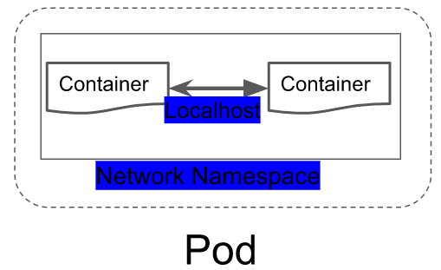
Pods & Namespaces
Logical Collection of one or more containers
Smallest unit of work
Namespaces – Divide the cluster resources between multiple users
Names of resources are unique within a namspace

Slide 29
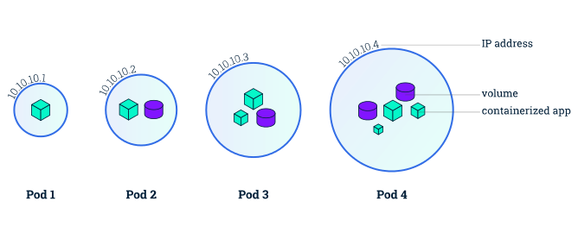
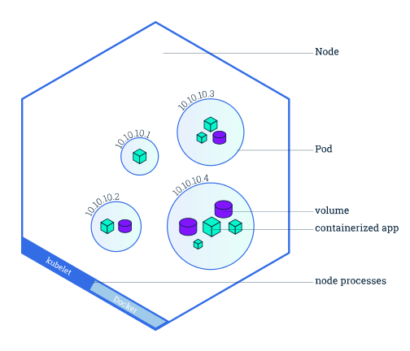
Pods & Nodes
A Pod is a group of one or more containers (such as Docker containers), with shared storage/network, and a specification for how to run the containers.
A Pod’s contents are always co-located and co-scheduled, and run in a shared context.
A Pod models an application-specific “logical host” - it contains one or more application containers which are relatively tightly coupled — in a pre-container world, being executed on the same physical or virtual machine would mean being executed on the same logical host.

Slide 30
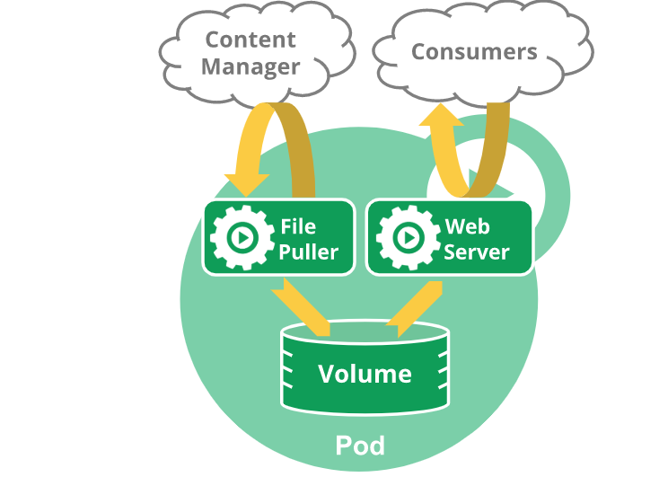
Pods
Every Pod gets its own IP address Pods on a node can communicate with all pods on all nodes without NAT
Agents on a node (e.g. system daemons, kubelet) can communicate with all pods on that node
Kubernetes IP addresses exist at the Pod scope - containers within a Pod share their network namespaces - including their IP address.
Containers within a Pod can all reach each other’s ports on localhost.

Slide 31
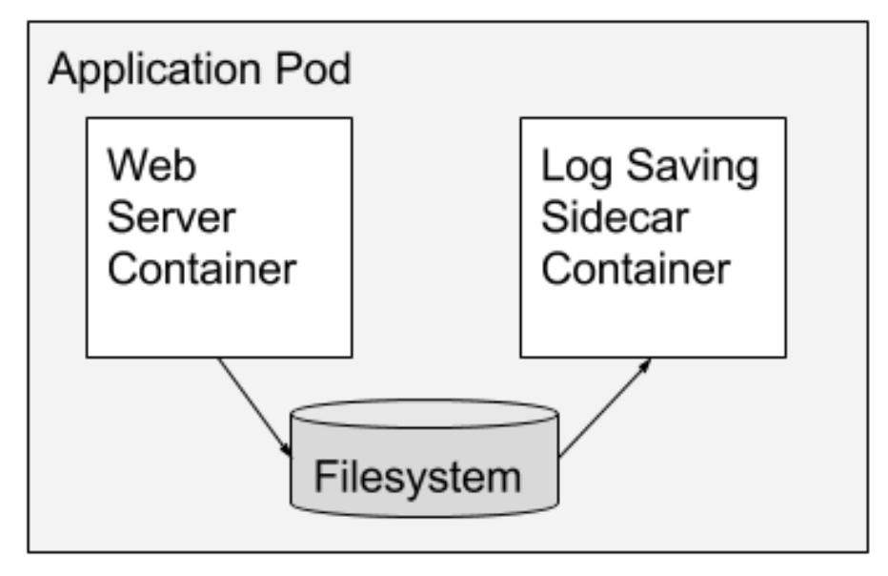
Sidecar Containers
Sidecar containers extend and enhance the "main" container, they take existing containers and make them better
Ref: https://kubernetes.io/blog/2015/06/the-distributed-system-toolkit-patterns/

Slide 32
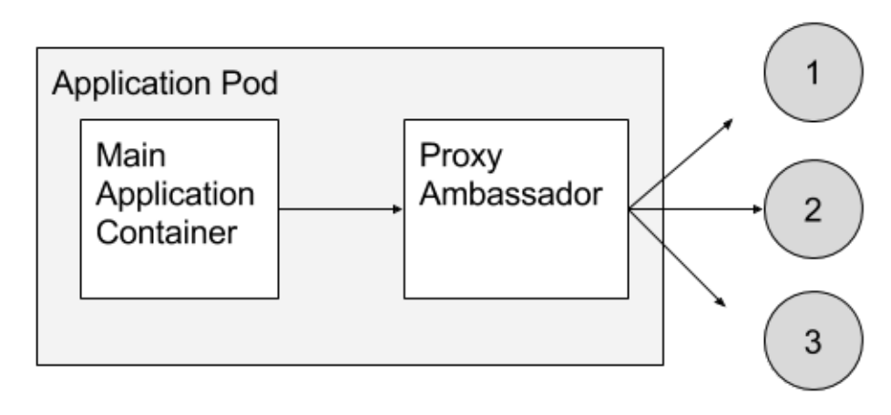
Ambassador Containers
Ambassador containers proxy a local connection to the world.
The ambassador is a proxy is responsible for splitting reads and writes and sending them on to the appropriate servers.

Slide 33
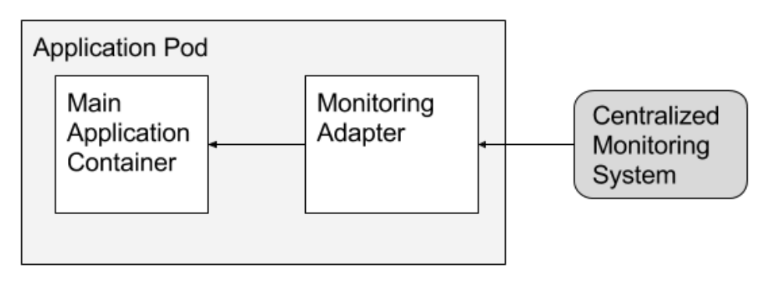
Adapter Containers
Adapter containers standardize and normalize output

Slide 34
Container Network Interface (CNI)
Container networking Interface is the mechanism through which containers can optionally connect to other containers, the host, and outside networks like the internet.
Container runtimes offer various networking modes and various plugins

Slide 35
Kubernetes Application Lifecycle Management

Slide 36
What are Deployments?
A Deployment provides declarative updates for Pods and ReplicaSets
Deployment is usually used for new releases and updates in kubernetes cluster.
The following are typical use cases for Deployments:
Create a Deployment to rollout a ReplicaSet.
Declare the new state of the Pods by updating the PodTemplateSpec of the Deployment.
Rollback to an earlier Deployment revision if the current state of the Deployment is not stable.
Scale up the Deployment to facilitate more load.
Pause the Deployment to apply multiple fixes to its PodTemplateSpec and then resume it to start a new rollout.

Slide 37
Labels
Labels are key/value pairs that are attached to objects, such as pods.
Used to specify identifying attributes of objects that are meaningful and relevant to users.
Labels can be used to organize and to select subsets of objects.
Labels can be attached to objects at creation time and subsequently added and modified at any time.
Examples:
"release" : "stable", "release" : "canary"
"environment" : "dev", "environment" : "qa", "environment" : "production"
"tier" : "frontend", "tier" : "backend", "tier" : "cache"
Labels are the key/value pairs that can be attached to kubernetes objects, such as pods, nodes. Labels can used for identifying attributes of objects that are meaningful and relevant to users. You can attach labels to kubernetes objects at creation time or you can attach them laters.

Slide 38
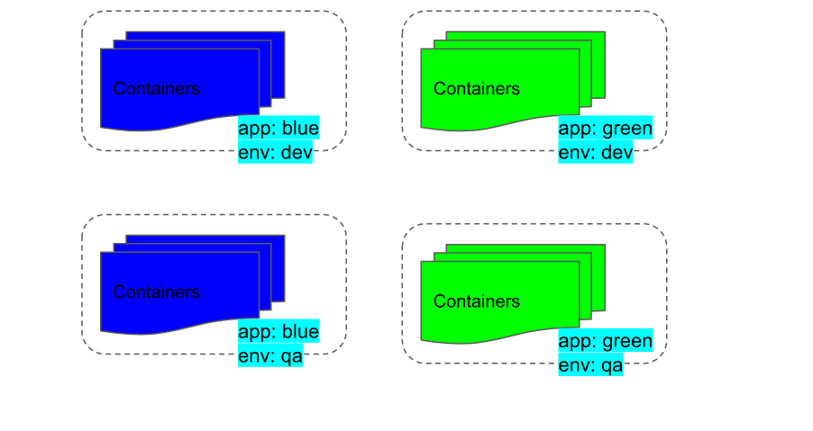
Working with Labels

Slide 39
Selectors
Kubernetes selector allows us to select Kubernetes resources based on the value of labels and resource fields assigned to a group of pods or nodes.
It is useful when we have to get details or perform any action on a group of Kubernetes resources or when we have to deploy a pod or group of pods on a specific group of nodes.
Equality-based requirement:
Allow filtering by label keys and values. Matching objects must satisfy all of the specified label constraints, though they may have additional labels as well. Three kinds of operators are admitted =,==,!=
Set-based requirement:
Allows filtering keys according to a set of values. Three kinds of operators are supported: in,notin and exists (only the key identifier). For example:
environment in (production, qa)
tier notin (frontend, backend)
partition
!partition

Slide 40
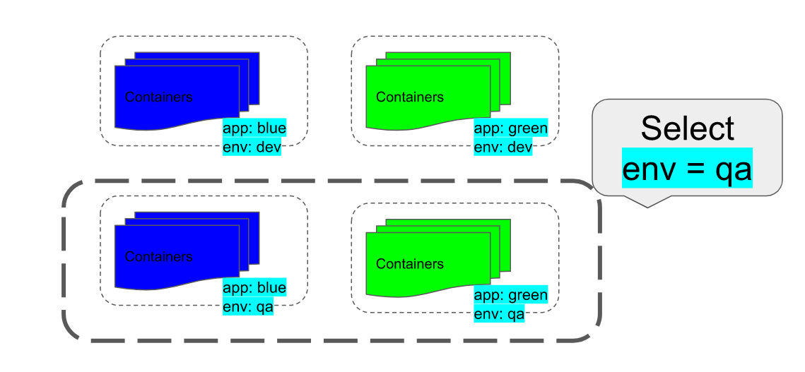
Working with Selectors
Note :https://kubernetes.io/docs/concepts/overview/working-with-objects/labels/

Slide 41
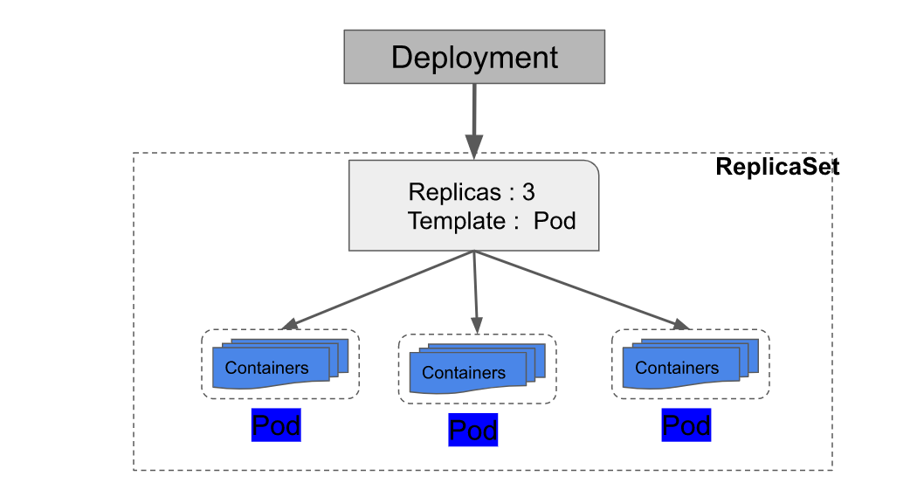
Working with Deployments

Slide 42
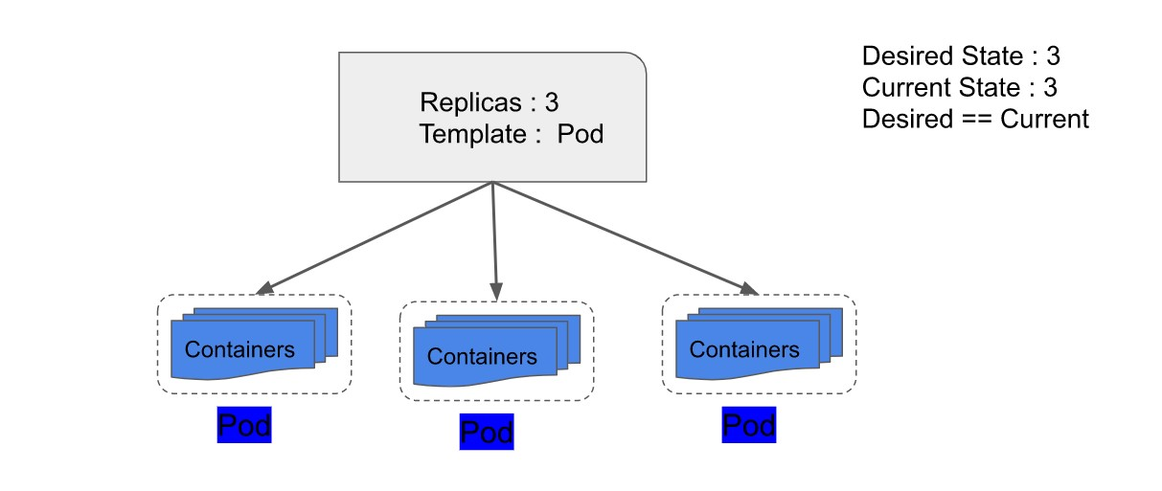
ReplicaSets
ReplicaSet ensures that a specified number of pod replicas are running at any given time
ReplicaSets are mainly used by deployments, which manages updates to the pod.
The .spec.template.metadata.labels must match the .spec.selector, or it will be rejected by the API.

Slide 43
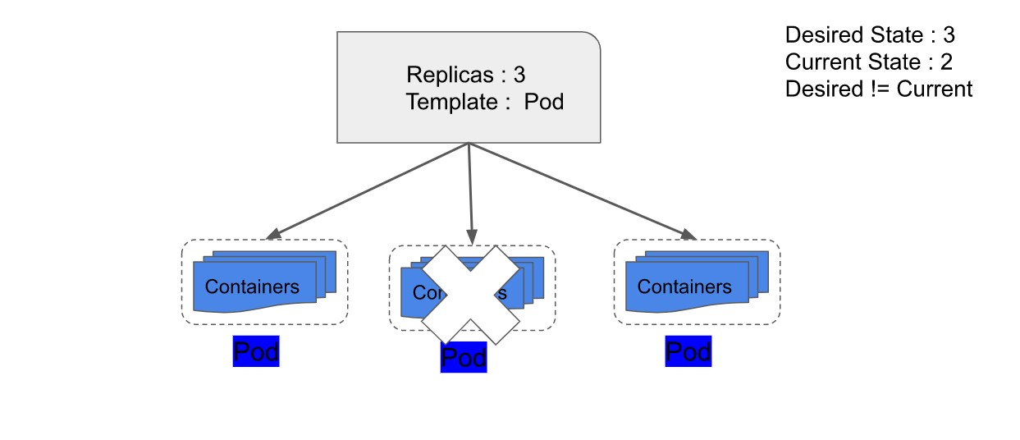
Working with Replica Sets

Slide 44
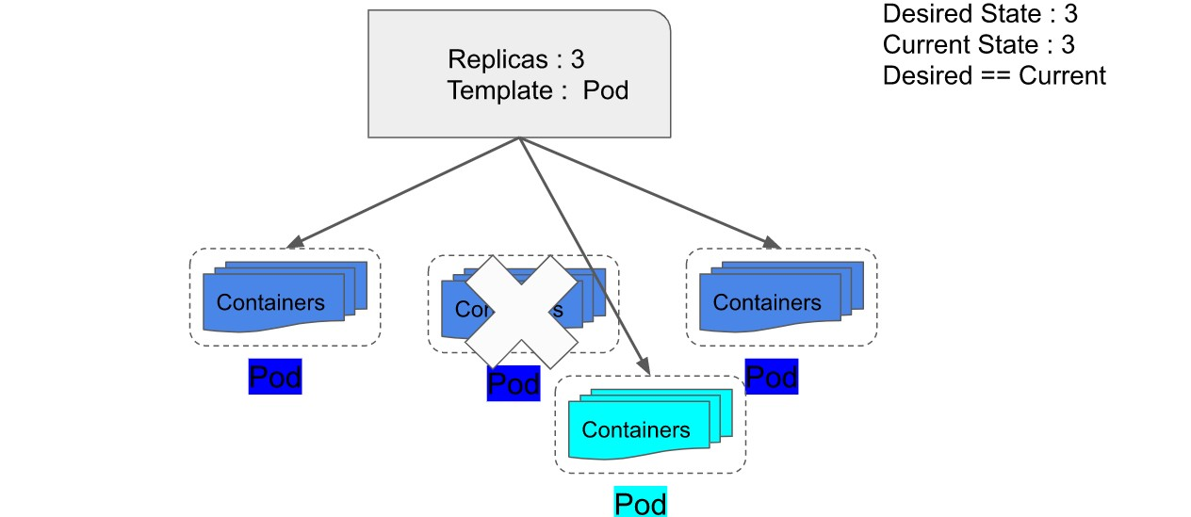
Working with Replica Sets

Slide 45
Rolling Updates with Deployments
Rolling updates allow the following actions:
Promote an application from one environment to another (via container image updates)
Rollback to previous versions
Continuous Integration and Continuous Delivery of applications with zero downtime

Slide 46
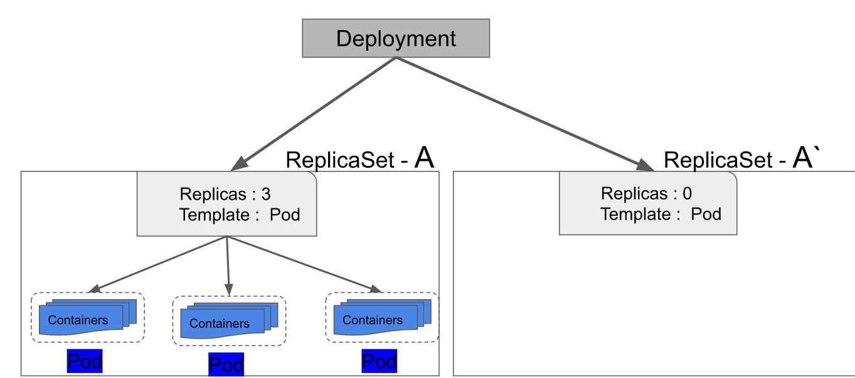
Working with Rolling Updates

Slide 47
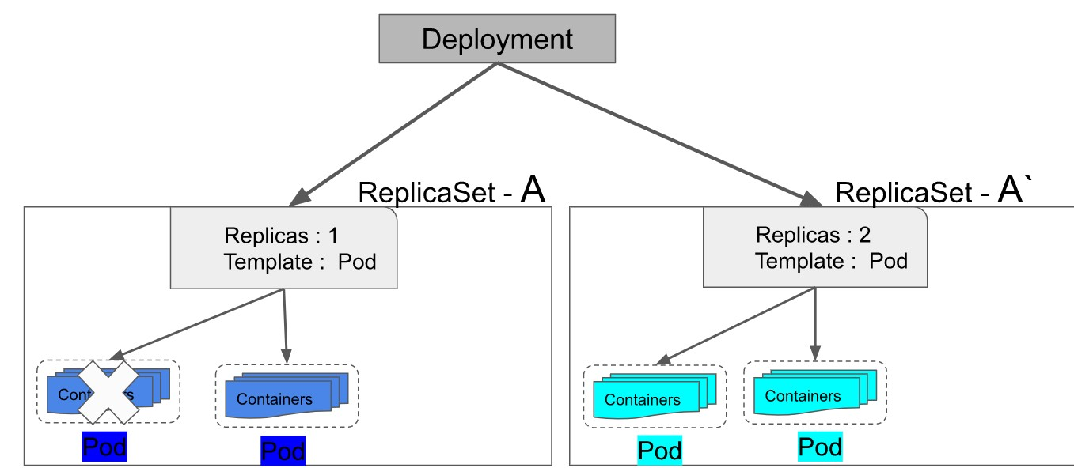
Working with Rolling Updates

Slide 48
Best Practices for Deployment
Implement Continuous Security Vulnerability Scanning
Regularly Apply Security Updates to Your Environment
Ensure That Only Authorized Images are Used in Your Environment
Limit Direct Access to Kubernetes Nodes
Create Administrative Boundaries between Resources
Implement Network Segmentation
Apply Security Context to Your Pods and Containers
Log Everything
Ref: Security Best Practices for Kubernetes Deployment | Kubernetes

Slide 49
Kubernetes Networking

Slide 50
Kubernetes Network Model
Every Pod gets its own IP address.
Pods on a node can communicate with all pods on all nodes without NAT.
Agents on a node can communicate with all pods on that node.
Containers within a Pod share their network namespaces (IP address and MAC address).
Containers within a Pod can all reach each other's ports on localhost.

Slide 51

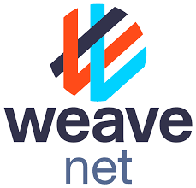
Implement Network Model
Weave Net is a resilient and simple to use network for Kubernetes and its hosted applications. Weave Net runs as a CNI plug-in or stand-alone
Calico is an open source networking and network security solution for containers, virtual machines, and native host-based workloads.
Flannel is a very simple overlay network that satisfies the Kubernetes requirements

Slide 52
What is a Service?
A service can be defined as a logical set of pods.
It can be defined as an abstraction on the top of the pod which provides a single IP address and DNS name by which pods can be accessed.
With Service, it is very easy to manage load balancing configuration. It helps pods to scale very easily.
A service is a REST object in Kubernetes whose definition can be posted to Kubernetes ApiServer on the Kubernetes master.

Slide 53
Need for Kubernetes Services
Kubernetes Pods details constantly changes . They may die and be restarted anywhere in the cluster at any time.
When restarted, a Pod may be assigned a different IP address.
A Kubernetes Service create a logical connection to the set of Pods and a policy by which to access them. The set of Pods targeted by a Service is usually determined by a Label Selector.

Slide 54
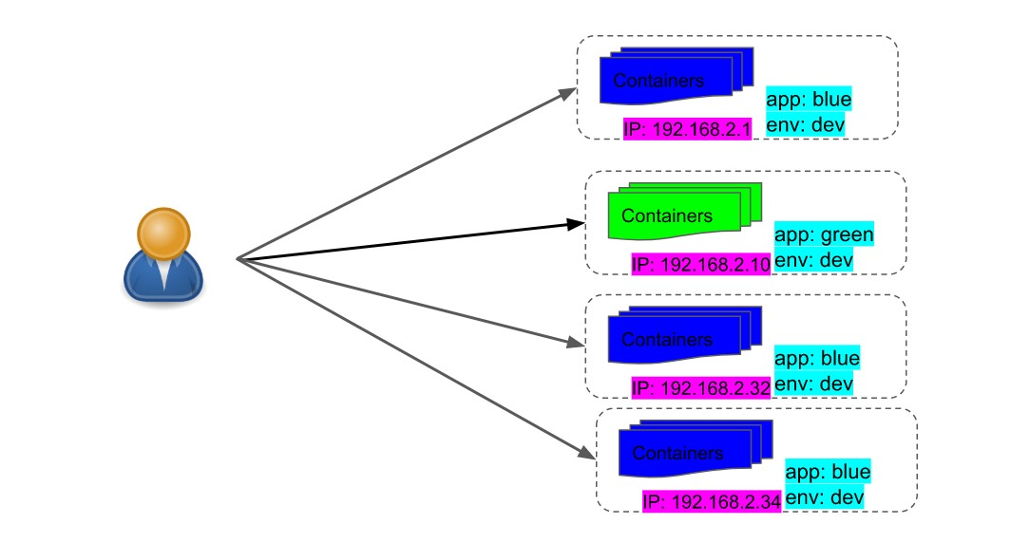
Need for Kubernetes Services

Slide 55
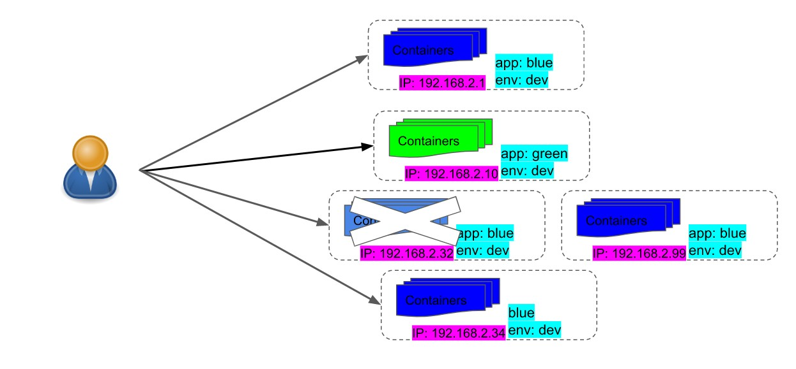
Need for Kubernetes Services

Slide 56
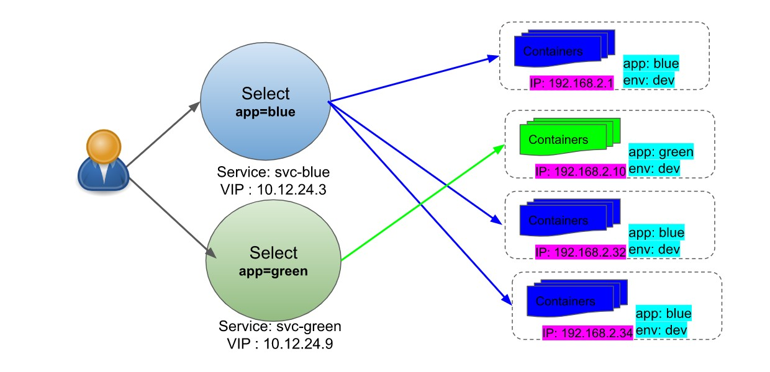
Need for Kubernetes Services

Slide 57
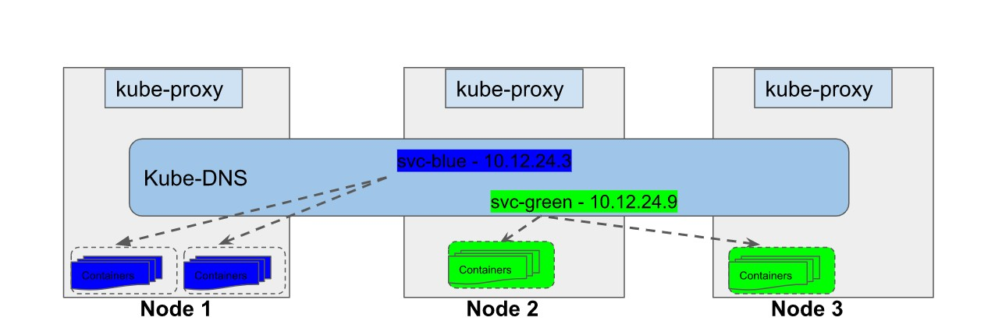
Cluster-Internal Ip (Default)
This is the default service type. Choosing this value means that you want this service to be reachable only from inside of the cluster.

Slide 58
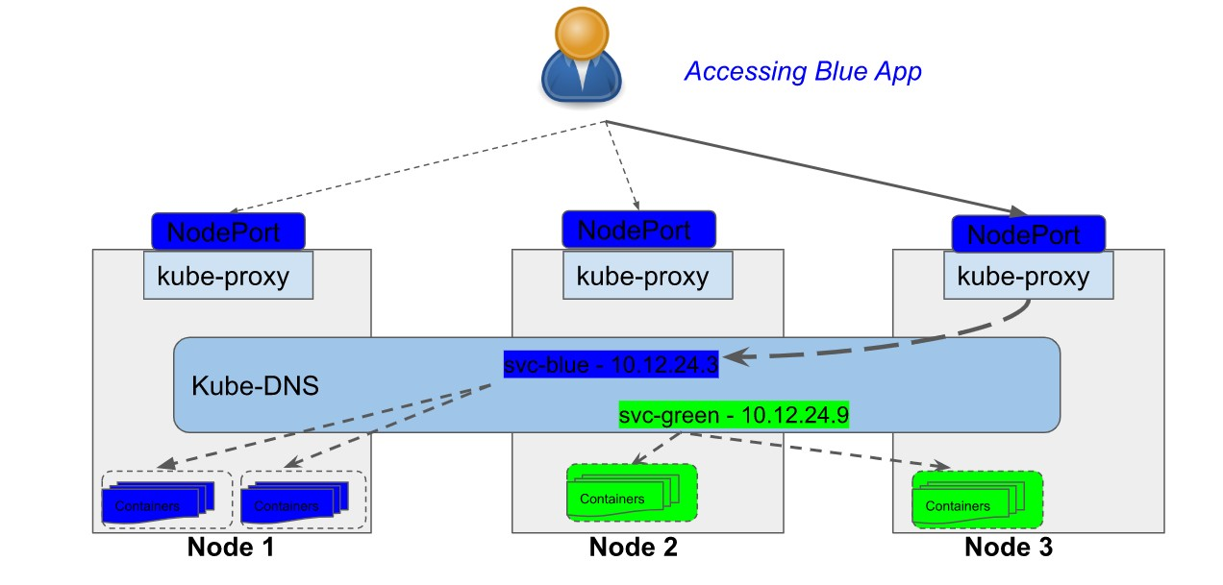
Service – NodePort (External)
Exposes the Service on each Node's IP at a static port (NodePort). Application is reachable from internt , by requesting <NodeIP>:<NodePort>.

Slide 59
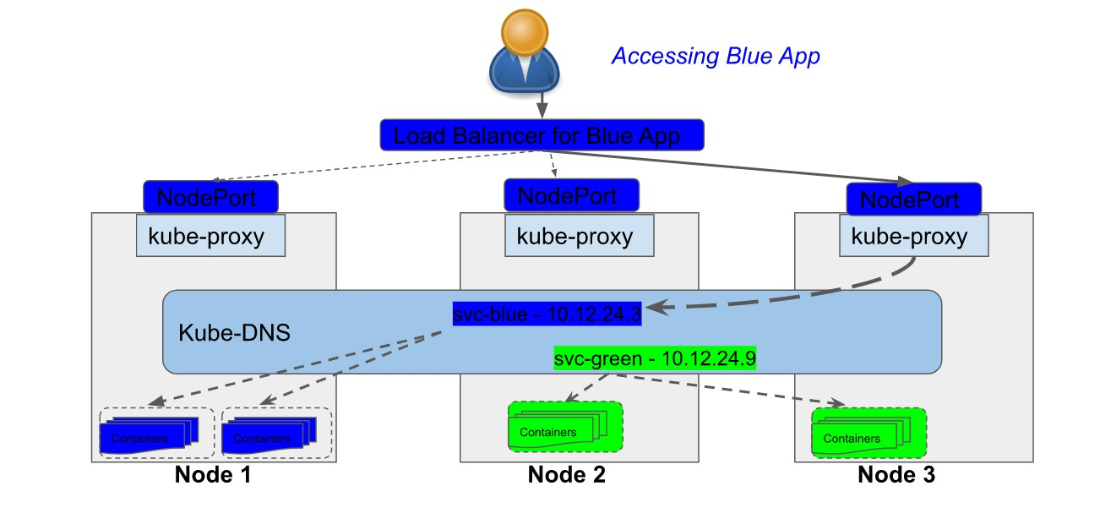
Service – Load Balancer (External)
Exposes the Service externally using a cloud provider's load balancer

Slide 60
THANK YOU

